Slide 1


Implementation of the WHO FCTC and Ratification of the Protocol to Eliminate Illicit Trade in Tobacco Products in Georgia
April, 2018
National Center for Disease Control & Public Health
www.ncdc.ge

Slide 2
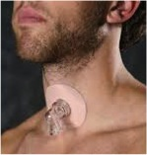
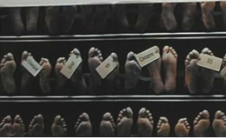

Scope of Tobacco Epidemy in Georgia
Active Smoker- 33%
Second hand Smokers - 39%
2/3 of the population is exposed to tobacco smoke
Tobacco related deaths -11400, or every fifth (!) death
Annualy:
Tobacco related illness - 70 000
Notes:
გარდაცვალების საშუალო ასაკი 56 წელი

Slide 3


Georgia EU Association Agreement Agenda
AA was signed in 2015, entered into force in 2016
2014-2017 – first phase → 2017-2020 – second phase
Considers approximation of tobacco control legislation to respective EU Directives and standards
დაავადებათა კონტროლისა და საზოგადოებრივი ჯანმრთელობის ეროვნული ცენტრი
www.ncdc.ge

Slide 4
EU Association Agreement Obligations
TAPS DIRECTIVE 2003/33/EC | 4 years after AA enters into force | In process
Tobacco Products Directive 2001/37/EC – (Georgia is ready to approximate to updated EU Directive 2014/40/EC) | 6 years after AA enters into force | In process
EC Recommendation 2003/54/EC | No deadline | In process
EC Recommendation 2009/C 296/02 | No deadline | In process

Slide 5
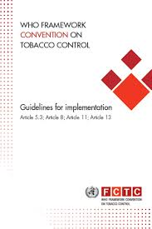

2003 - National Tobacco Control Law (TBCL) of Georgia 2005 - WHO FCTC was ratified 2006 - the Convention went into force 2008, 2010 - TBCL revised Though Compliance with time bound articles 8, 11 and 13 was not achieved 2013 – National Multisectoral Tobacco Control State Committee (Gov. Decre #58) National Tobacco Control Strategy (Gov. Decree #196) and Action Plan (Gov. Decree #304) 2014 - National Action Plan of EU Association Agreement (#513) 2015, 2016 - Health Promotion State Program “Public Movement for Healthy Georgia”
Tobacco Control Landscape in Georgia Prior to 2017
National Center for Disease Control & Public Health
www.ncdc.ge
Notes:
Georgia took the international responsibility to implement all obligations under the Convention. Only very few from these obligation were fulfilled up until 2017;

Slide 6
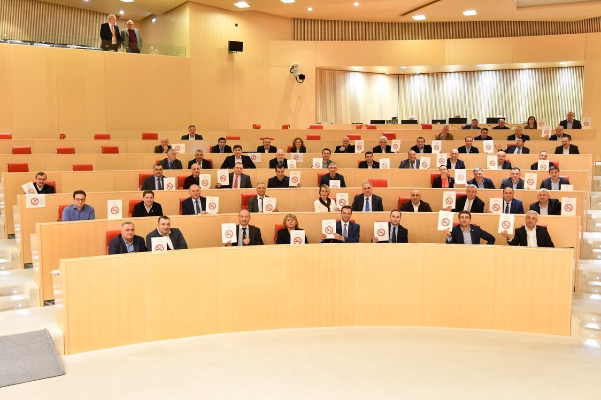
2017
A set of new generation tobacco control laws was adopted

Slide 7
Main changes in new TC law
Total ban of smoking (including e-cigarettes and hookah) in all public transport and buildings, except of private homes, prisons, casinos, cigar bars and private taxis – May 1, 2018
Ban of all forms of advertisement, sponsorship and promotion of tobacco, its accessories and devices for its use, including ban of display at points of sales and restriction of demonstration of smoking in movies and massive performances - May 1, 2018 to September 1, 2018
Increasing size of health warnings to 65% and obligatory pictorial warnings on front side of the packages of smoking tobacco – September1, 2018 (transitional periods extended until January 2019)
Introducing standardized cigarette packaging (plain packaging) - January 2023

Slide 8
Main changes in new TC law
Regulation of e-cigarettes and refillable containers as tobacco products – May 1, 2018
Ban of writing "menthol", "mild", "extra", "ultra" on the packages. – May 1, 2018
Ban of direct or indirect participation of industry in decision making on health issues – May 1, 2018
Ban of "drive tobacco" (drive through cabins, from which one can buy tobacco without getting out from the car) – May 1, 2018
Ban of tobacco retail trade using internet or post – May 1, 2018
Updated model of administration of the law, namely transferring burden of responsibility to organizations and its owners for smoking ban, increasing amount of fines for violations, no court decision needed - 1 violation 1 controlling body – May 1, 2018

Slide 9
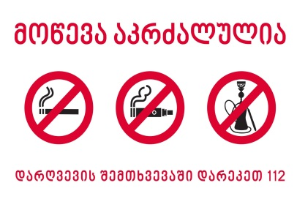
From May 1:
All enclosed public places must be tobacco-free
დაავადებათა კონტროლისა და საზოგადოებრივი ჯანმრთელობის ეროვნული ცენტრი
www.ncdc.ge

Slide 10
National Strategic Priorities for WHO FCTC Implementation
Implementation of FCTC Article 5 obligations
Strengthening implementation of timebound articles of the WHO FCTC
Total ban of smoking in all enclosed public/work places and specific outdoor areas designated for youth and hazardous materials
Total ban of tobacco advertisement, sponsorship and promotion
At least 65% of pictorial health warnings on the surface of tobacco packages
Strengthening tobacco control law enforcement/administration
Strengthening of tobacco taxation

Slide 11
Pillars of Law Enforcement
Increased budget of State Health Promotion Program – 2018-2019 (800,000 GEL)
WHO FCTC2030 Project (only country from EU region)
Bloomberg Philanthropies Grant Program – “Supporting Endorsement and Enforcement of Strengthened Legislation on Tobacco Demand Reduction in Georgia in order to meet WHO FCTC Requirements”

Slide 12
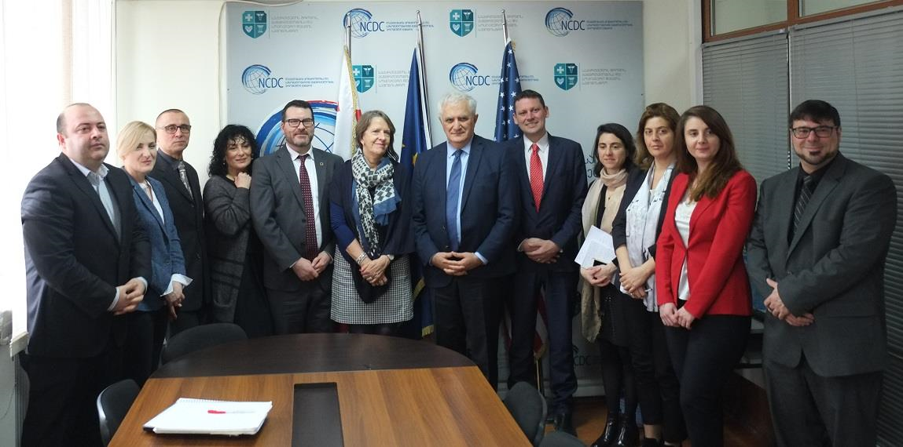
Launch of the FCTC2030 Project and Results of the WHO FCTC Investment Case in Georgia 27 February 2018 Ministry of Labour, Health and Social Affairs

Slide 13
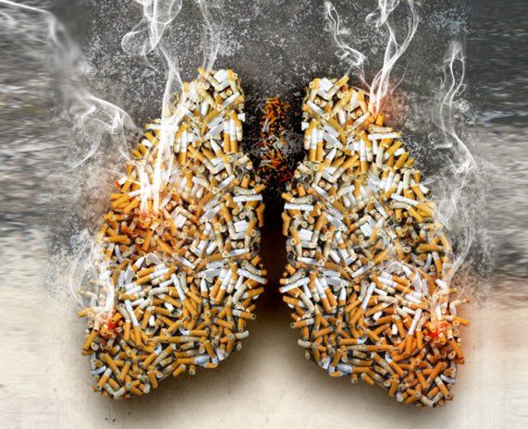

Summary findings of the WHO FCTC Investment Case
11,400 Georgian citizens die annually because of tobacco-related diseases, out of which
9,300 annual deaths due to smoking
2,100 annual deaths due to second hand smoke exposure
Total annual direct and indirect costs associated with tobacco-use: GEL 824.9 million
This is equivalent to an annual loss of 2.43% of GDP
დაავადებათა კონტროლისა და საზოგადოებრივი ჯანმრთელობის ეროვნული ცენტრი
www.ncdc.ge

Slide 14
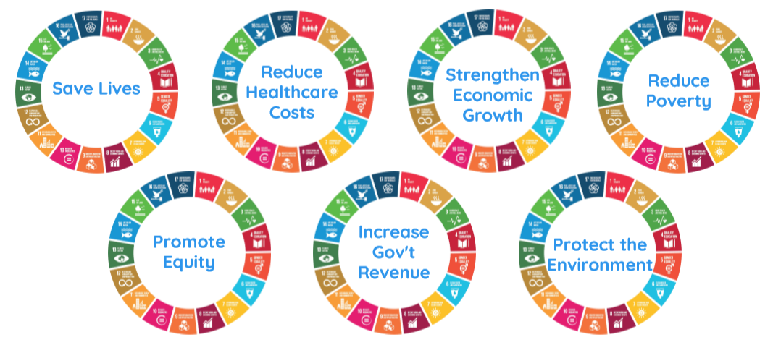
Summary findings: Intervention Scenario
Investments in four FCTC measures/interventions* now:
will save 53,110 lives and have positive impact for future well-being of Georgian citizens
will result in GEL 3.6 billion total economic gains over 15 years
For every GEL 1 invested in key FCTC interventions now:
Georgia receives total economic gain of GEL 161 over the first 5 years and GEL 357 after 15 years
*(i) increasing taxes, (ii) complete ban on indoor smoking, (iii) banning advertising, sponsorship & promotion, (iv) labeling and packaging
დაავადებათა კონტროლისა და საზოგადოებრივი ჯანმრთელობის ეროვნული ცენტრი
www.ncdc.ge

Slide 15
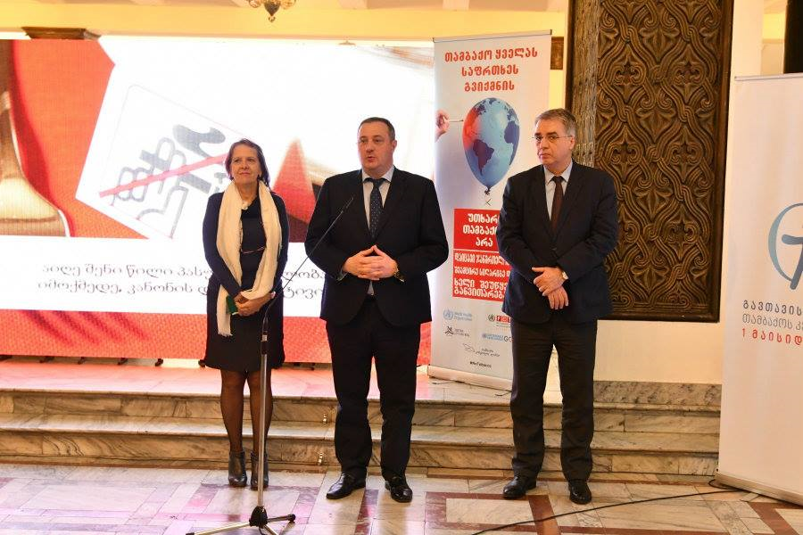
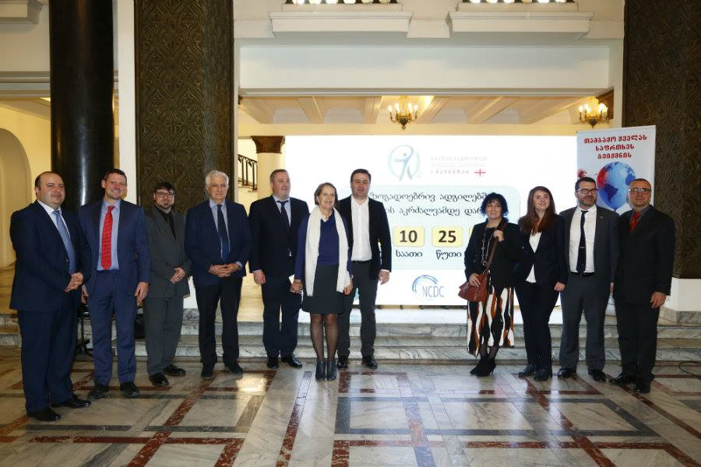
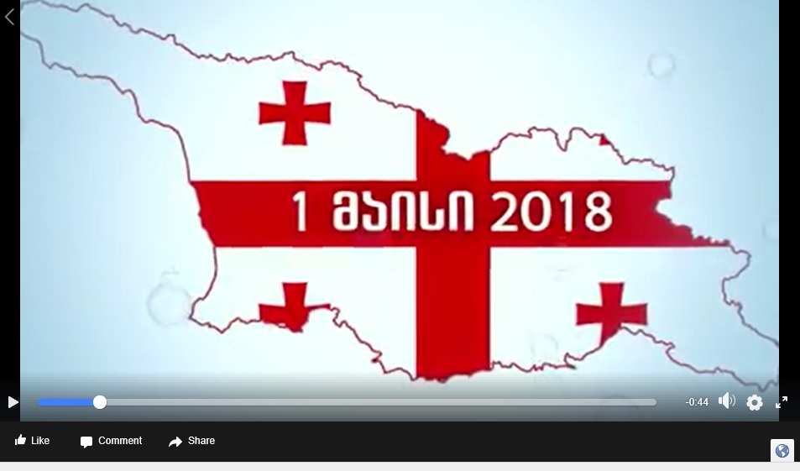

Launch of Tobacco Control Nationwide Communication Campaign, February 28, 2018
Smoke-free Law online timer
http://www.ncdc.ge/Pages/User/Video.aspx?ID=279f5ad3-4b39-4284-b546-600bace73ec1

Slide 16
Protocol to Eliminate Illicit Trade in Tobacco Products
Georgia has not signed the Protocol yet
Official procedure for the signature and ratification of the Protocol was initiated in 2014 and then again in 2016
Ministry of Labour, Health and Social Affairs has submitted the Protocol to the Ministry of Foreign Affairs
Next Steps to be followed up by the Ministry of Foreign Affairs
National Center for Disease Control & Public Health
www.ncdc.ge

Slide 17
Next steps for accelerating implementation of the
WHO FCTC in Georgia
Effective implementation of the recently adopted tobacco control law
Strengthen tobacco control research based evidence
Think beyond health – multisectoral involvement/tobacco control in development agendas
Strengthen collaboration with civil society
Strengthen international knowledge and experience sharing practices
Be innovative – sustainable funding mechanisms
Be visionary - aim for TOBACCO END GAME
National Center for Disease Control & Public Health
www.ncdc.ge

Slide 18

National Center for Disease Control & Public Health
www.ncdc.ge

